Slide 2
Nano Server: The Future of Windows Server Starts Now
BRK2461
Jeffrey Snover
Distinguished Engineer
Andrew Mason
Principal PM Manager

Slide 3
Agenda
What we hear from customers
Our Journey
Nano Server
Preliminary Results
Status and Roadmap
Call to Action/Go Dos

Slide 4
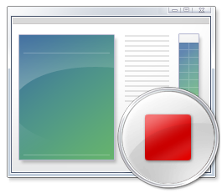
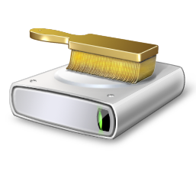

Voice of the Customer
Reboots impact my business
Why do I have to reboot because of a patch to a component I never use?
When a reboot is required, the systems need to be back in service ASAP
Server images are too big
Large images take a long time to install and configure
Transferring images consumes too much network bandwidth
Storing images requires too much disk space
Infrastructure requires too many resources
If the OS consumes fewer resources, I can increase my VM density
Higher VM density lowers my costs and increases my efficiency & margins

Slide 5
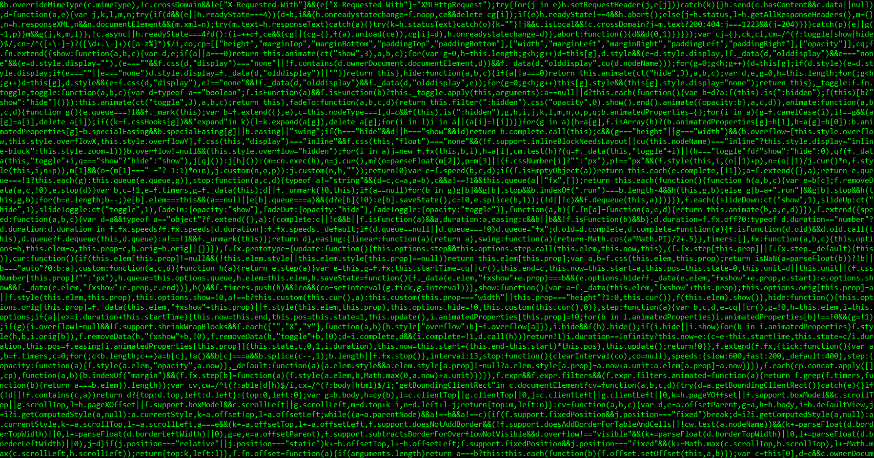


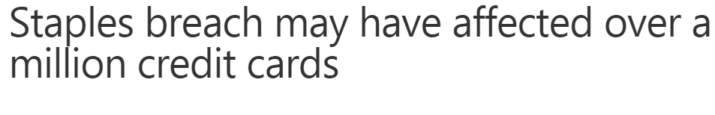
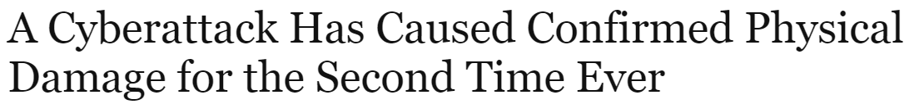
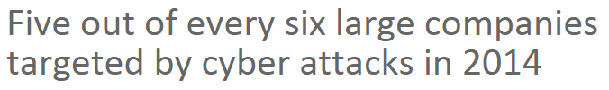
Security Impact

Slide 6
I want just the components I need and nothing more

Slide 7
Our Server Journey*
* Admin GUIs on servers are poison

Slide 8
Our Cloud Journey
Azure
Patches and reboots interrupt service delivery
(*VERY large # of servers) * (large OS resource consumption) => COGS
Provisioning large host images competes for network resources
Cloud Platform System (CPS)
Cloud-in-box running on 1-4 racks using System Center & Windows Server
Setup time needs to be shortened
Patches and reboots result in service disruption
Fully loaded CPS would live migrate > 16TB for every host OS patch
Network capacity could have otherwise gone to business uses
Reboots: Compute host ~2 minutes / Storage host ~5 minutes

Slide 9
We need server configuration optimized for the cloud

Slide 10
Nano Server - Next Step in Our Cloud Journey
A new headless, 64-bit only, deployment option for Windows Server
Deep refactoring focused on
CloudOS infrastructure
Born-in-the-cloud applications
Follow the Server Core pattern

Slide 11
Nano Server - Roles & Features
Zero-footprint model
Server Roles and Optional Features live outside of Nano Server
Standalone packages that install like applications
Key Roles & Features
Hyper-V, Storage (SoFS), and Clustering
Core CLR, ASP.NET 5 & PaaS
Full Windows Server driver support
Antimalware Built-in
System Center and Apps Insight agents to follow

Slide 12
Nano Server

Slide 13
Nano Server - Management
Eliminating the need to ever sit in front of a server
Configuration via PowerShell Desired State Configuration (DSC)
Remote management/automation via Core PowerShell and WMI
Integrate into DevOps toolchains
Thursday 1:30 – Remotely Managing Nano Server – Room S105D

Slide 14
Nano Server - Core PowerShell
Refactored to run on CoreCLR
Full PowerShell language compatibility & remoting
Invoke-Command, New-PSSession, Enter-PSSession, etc.
Most core engine components
Support for all cmdlet types: C#, Script, and CIM
Limited set of cmdlets initially

Slide 15
Core PowerShell

Slide 16
Remote Server Management Tools
Web-based
Includes replacements for local-only tools
Task Manager
Registry Editor
Event Viewer
Device Manager
Sconfig ----------------------------
Control Panel
File Explorer
Performance Monitor
Disk Management
Users/Groups Manager
Also manages Server Core and Server with GUI

Slide 17
Remote Server Management Tools

Slide 18
Nano Server - Cloud Application platform
Born-in-the-cloud application support
Subset of Win32
CoreCLR, PaaS, and ASP.NET 5
Available everywhere
Host OS for physical hardware
Guest OS in a VM
Windows Server containers
Hyper-V containers
Future additions
PowerShell Desired State Configuration (DSC) & PackageManagement
Additional Roles and Application Frameworks

Slide 19
Server Application Development
Deep refactoring
Client stack for RDS
Developers target Server or Nano Server
Deploy to Physical, Virtual or Containers
Remote Desktop Server
Local Admin Tools
Client
(aka Server w/a GUI)
(Aka Full Server)
Physical, Virtual, Containers
Server
Nano Server

Slide 20
Nano Server - Developer Experience
Windows SDK & Visual Studio 2015 target Nano Server
Download tooling from the VS gallery
Rich design-time experience
Project template, full IntelliSense, error squiggles, etc.
Full remote debugging experience

Slide 21
Reverse Forwarders
A missing DLL will result in an app failing to run
Provide a way to run existing apps without recompiling for Nano Server
With Reverse Forwarders your apps will load and API calls in those DLLs will either result in
API call will succeeding if the API is in the Nano Server boundary
Return of Not Implemented if it is not within the Nano Server boundary
Does not eliminate the need to refactor code to what is available in Nano Server

Slide 22
Reverse Forwarders (cont.)
Optional package that can be included in a Nano Server image when needed
Available reverse forwarders include:
advapi32.dll
comctl32.dll
comdlg32.dll
gdi32.dll
kernel32.dll
ole32.dll
psapi.dll
shell32.dll
shlwapi.dll
user32.dll
version.dll
winmm.dll

Slide 23
What runs today with the Reverse Forwarders?
Chef
PHP
Nginx
Python 3.5
Node.js
GO
Redis
MySQL
OpenSSL
Java (OpenJDK)
Ruby (2.1.5)
SQLite

Slide 24
DevOps with Nano Server using Chef

Slide 25
Preliminary Results

Slide 26
Servicing Improvements*
23
26
11
23
6
9
8
3
2
* Analysis based on all patches released in 2014

Slide 27
Security Improvements
46
31
98
73
22
12

Slide 28
Resource Utilization Improvements
26
255
139
21
150
61

Slide 29
Deployment Improvements
300
6.3
4.84
40
.4
.41

Slide 30
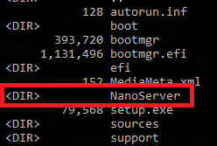
Nano Server in Windows Server vNext
An installation option, like Server Core
Not listed in Setup because image must be customized with drivers
Separate folder on the Windows Server media
Available in the Windows Server Technical Preview 2 released this week

Slide 31
Installing Drivers
For the leanest image, install just the drivers your hardware requires
Dism /Add-Driver /driver:<path>
Nano Server includes a package of all drivers in Server Core
Dism /Add-Package /PackagePath:.\packages\Microsoft-NanoServer-OEM-Drivers-Package.cab
To run Nano Server as a VM install
Dism /Add-Package /PackagePath:.\packagesMicrosoft-NanoServer-Guest-Package.cab

Slide 32
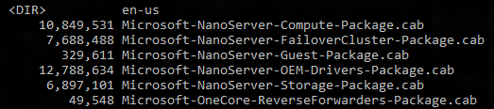
Installing Roles and Features
Nano Server folder has a Packages sub-folder
Dism /Add-Package /PackagePath:.\packages\<package>
Dism /Add-Package /PackagePath:.\packages\en-us\<package>

Slide 33
Installing Agents and Tools on Nano Server
No MSI support in Nano Server
Current builds of Nano Server require xcopy or custom PowerShell script
Nano Server Installer in the works, which will provide
Install
Uninstall
Inventory
Online and offline installation support

Slide 34
Deploying Nano Server
Generate a VHD from NanoServer.wim
Download Convert-WindowsImage.ps1 from the Script Center: https://gallery.technet.microsoft.com/scriptcenter/Convert-WindowsImageps1-0fe23a8f
Run Convert-WindowsImage.ps1 -Sourcepath <path to wim> -VHD <path to new VHD file> –VHDformat VHD -Edition 1.
Dism /Apply-Image

Slide 35
Roadmap
Nano Server is the future nucleus of Windows Server
Target for cloud components and Born-in-the-Cloud applications
New foundation for all components
Provides a Just Enough OS model for all applications
Not everything will run on Nano Server
Server Core provides compatibility for existing Enterprise applications
Physical, Virtual, Containers
Existing Enterprise Applications
Born-in-the-Cloud
applications
Server Core
Nano Server

Slide 36
Call to Action/Go Dos
Shift your org and tools to full remote management of Server Core
Inventory tools and agents that only run locally
Check with your ISV for a remotable version
Send list of those with no remote equivalent and ISV to nanoserver@microsoft.com
Deploy Nano Server, your apps, and your tools
Deployment guide at: https://msdn.microsoft.com/en-us/library/mt126167.aspx
Give use feedback and let us know where you encounter difficulties: http://windowsserver.uservoice.com/forums/295068-nano-server
Remote Management feedback
http://windowsserver.uservoice.com/forums/295071-remote-management-tools

Slide 37
Learn more with FREE IT Pro Resources
Free technical training resources:
On-demand online training: http://aka.ms/moderninfrastructure
Free ebooks:
Deploying Hyper-V with Software-Defined Storage & Networking: http://aka.ms/deployinghyperv
Microsoft System Center: Integrated Cloud Platform: http://aka.ms/cloud-platform-ebook
Expand your Modern Infrastructure Knowledge
Get hands-on: Free virtual labs:
Microsoft Virtualization with Windows Server and System Center: http://aka.ms/virtualization-lab
Windows Azure Pack: Install and Configure: http://aka.ms/wap-lab
Join the IT Pro community:
Twitter @MS_ITPro

Slide 38
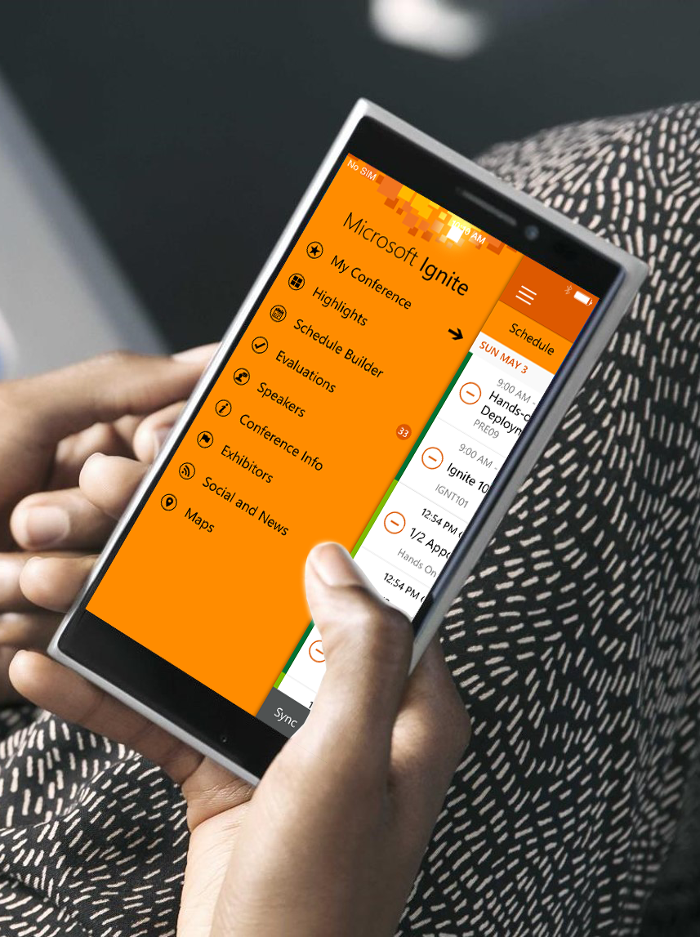

Please evaluate this session
Your feedback is important to us!
Visit Myignite at http://myignite.microsoft.com or download and use the Ignite Mobile App with the QR code above.

